Slide 1
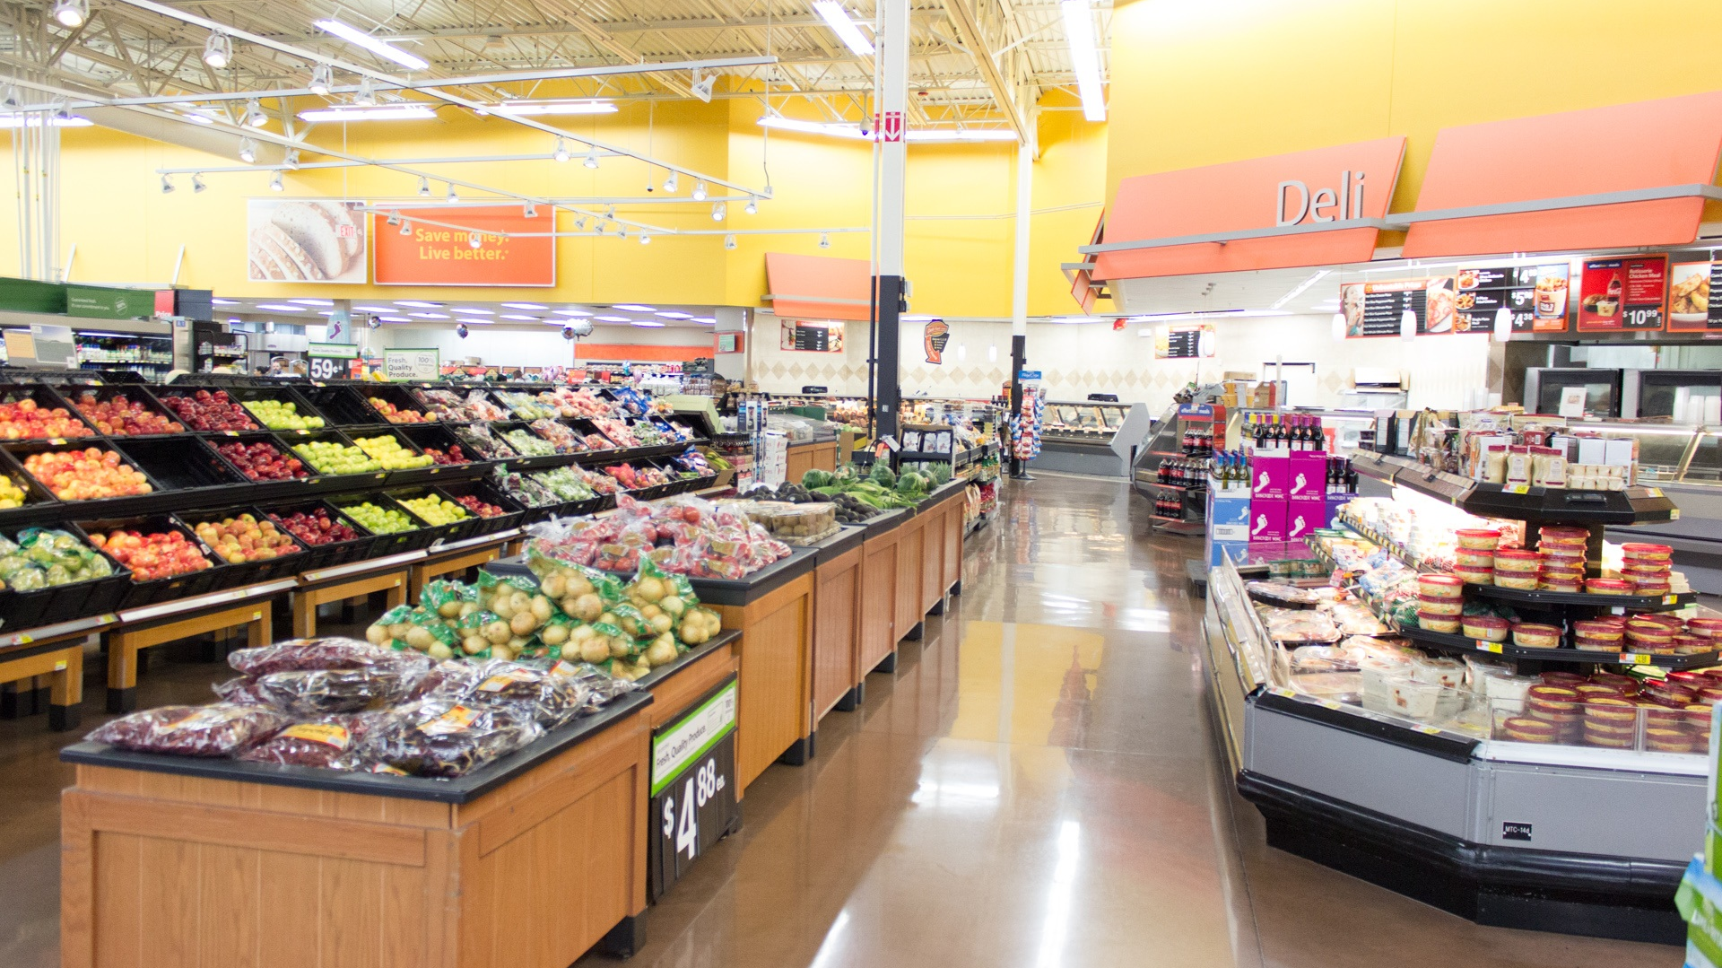

Store Item Demand Forecasting using Deep Learning

Slide 2


Demand Forecasting
Why is it needed?

Slide 3

Motivation
Inventory Management
Resource Management

Slide 4

Related Work [1]
ANN works efficiently over traditional methods.

Slide 5
Related Work [2]
LSTM is best among all ANN for Time series data forecasting.

Slide 6
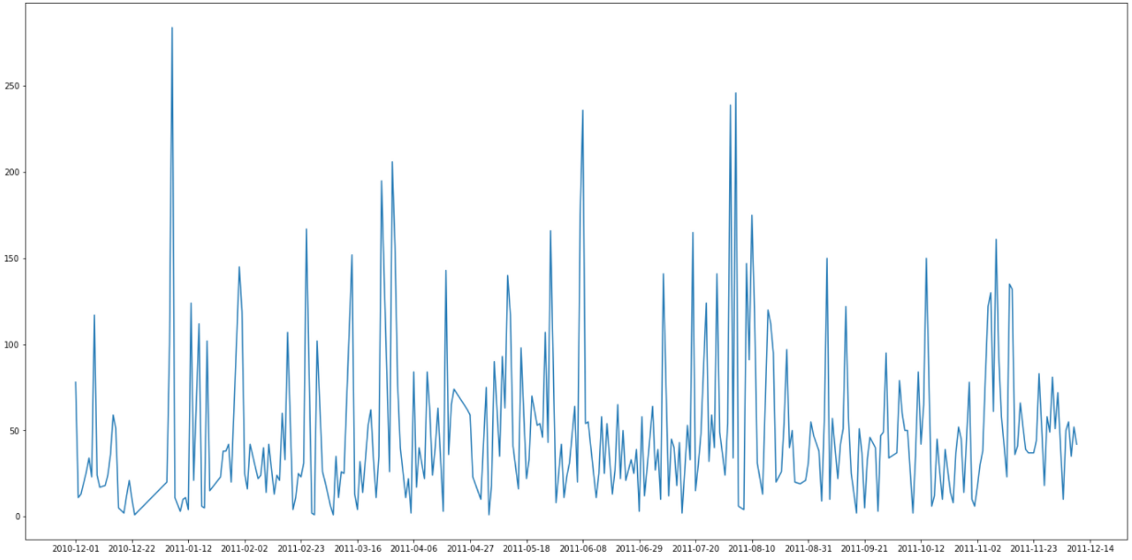
Method
LSTM
Random Forest
Residuals
Explanatory
TS Data
Data
Aggregated Prediction
Final Prediction

Slide 7
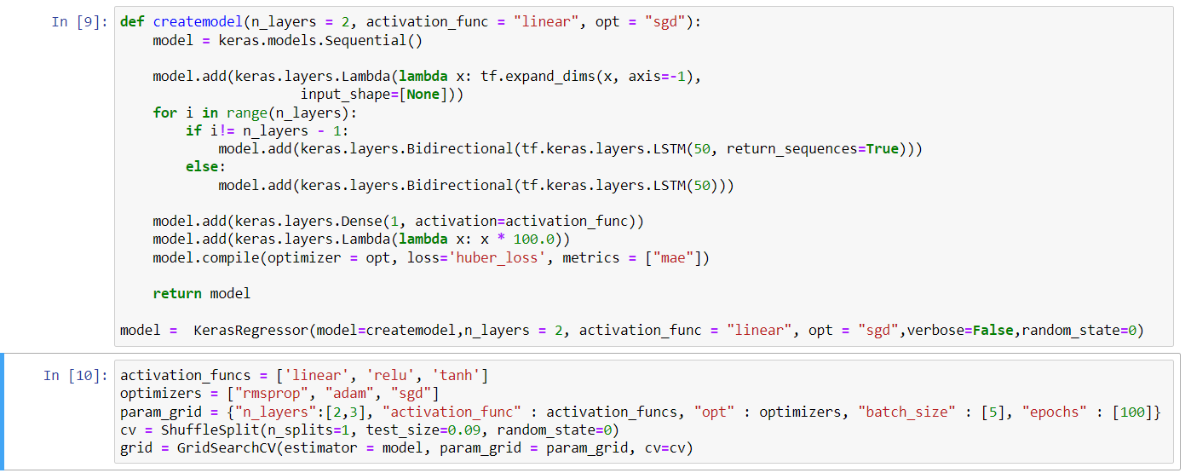

Slide 8

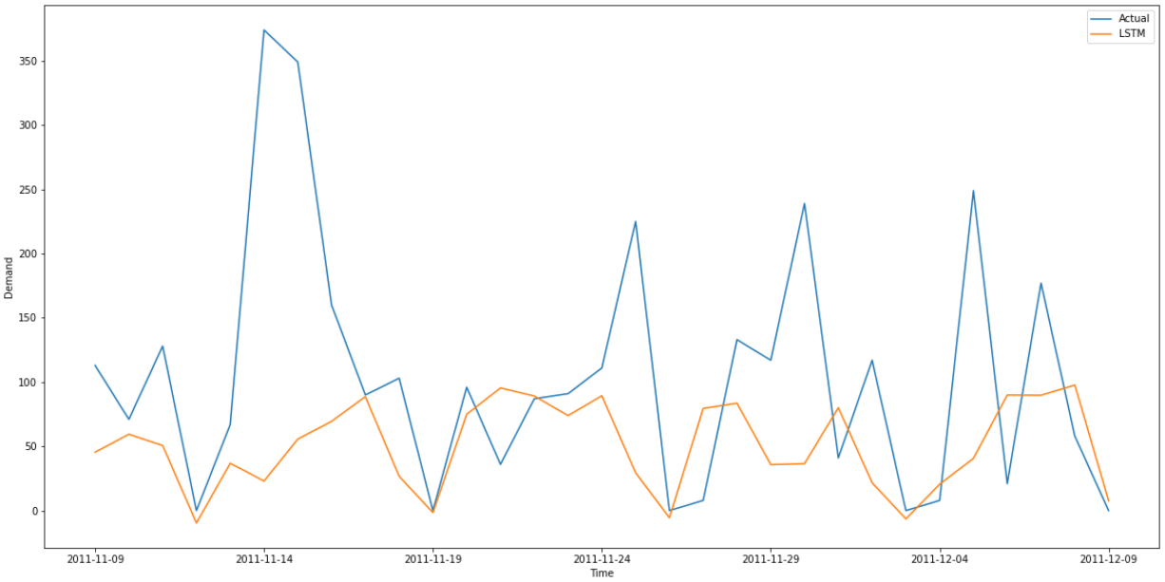
Results actual and LSTM – MAE 74.28

Slide 9
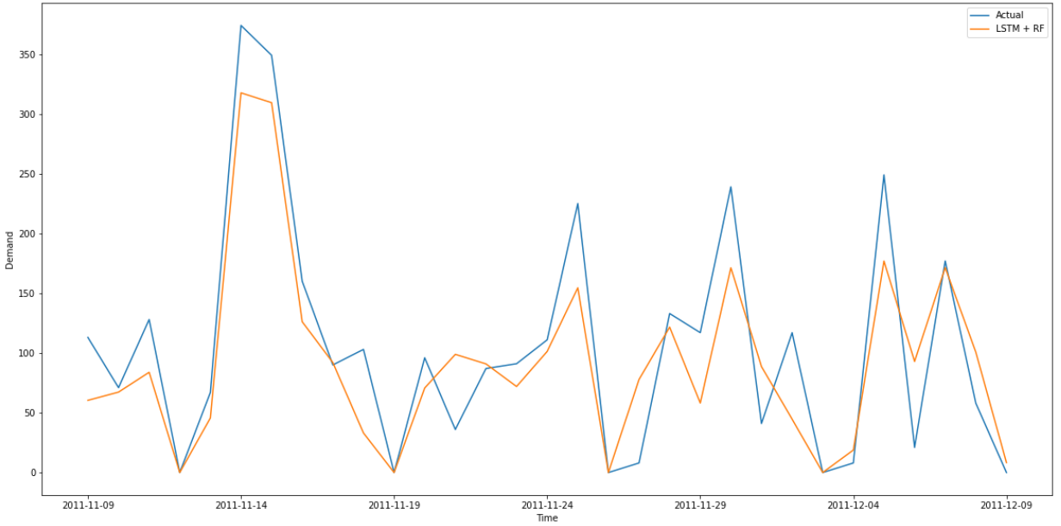
Results actual and LSTM + RF – MAE 34

Slide 10
Results actual and LSTM + RF – MAE 34

Slide 11
Thank You!!!

